Slide 1
DATA SCIENCE Mid Point Pitch
Presented by Team 2026:
Atif Tausif, Tausif Tusar, Mahdi Mahin, Raian Pial, Sushanta Sapkota
Date: 3/25/26

Slide 2
AGENDA
Introduction Methodology
Dataset
Business Intelligence
Application Stack

Slide 3
INTRODUCTION AND PROBLEM STATEMENT

Slide 4


Introduction and Problem
Context & Core Question
Goal
Build a predictive model that uses real-time weather data (rain, temperature) to forecast NYC traffic delays. Deliver live Tableau dashboards that city planners can use to anticipate congestion and adjust signal timing or transit schedules.
Questions
“Can weather-based predictions help reduce congestion during rush hour?”
“How much does rain and temperature affect traffic delays in NYC?”
“At what weather conditions do NYC traffic delays sharply increase, and can we identify a clear tipping point?”
Rain and temperature swings cause a lot of changes across NYC transportation. Longer commute times, more accidents, and shifts in bike share usage. City planners and transit agencies lack simple, data-backed models to predict how weather conditions affect congestion.
Core question:
How do weather conditions impact traffic delays and transportation patterns in NYC?
Stakeholders: City planners, DOT, transit agencies, commuters
4

Slide 5
METHOD AND PROCESS

Slide 6
How are we going to get the data, where are we storing it, how are we cleaning it, and how will stakeholders use and see it:
1. Pull historical weather from Open Meteo API (rain, temp, humidity)
2. Collect NYC traffic delay data from NYC OpenData portal
3. Store in MySQL database
4. Clean and merge datasets by date using Python (Pandas)
5. Build regression models (rain → delay time)
6. A/B test: weather-only model vs weather + prior traffic
7. Visualize predictions in Tableau dashboards for city planners
HOW
(FUNCTIONAL
REQUIREMENT /
OUR
APPROACH)

Slide 7
METHODOLOGY
Executive Summary
Data collection methodology:
Data collected using Open Meteo API and NYC OpenData traffic delay API.
Perform data wrangling
Merge weather + traffic by date. Handle missing records, remove holidays
Perform exploratory data analysis (EDA) Pandas
Perform interactive visual analytics using Tableau
Perform predictive analysis using regression models
Simple regression (rain → delay) and multivariate (rain + temp + day). Evaluate with R² and RMSE.
8

Slide 8
DATASET

Slide 9
The data was collected using various methods
Data collection was done using a GET request to the Open Meteo API for daily rain, temperature, and humidity data for NYC.
We also extracted NYC traffic speed/delay datasets from the NYC OpenData portal
We then cleaned the data, checked for holidays and events, and handled any missing values for any columns
The objective was to extract weather and traffic data, normalize it for comparison, and prepare it for the MySQL database and predictive modeling.
DATA
COLLECTION
10

Slide 10
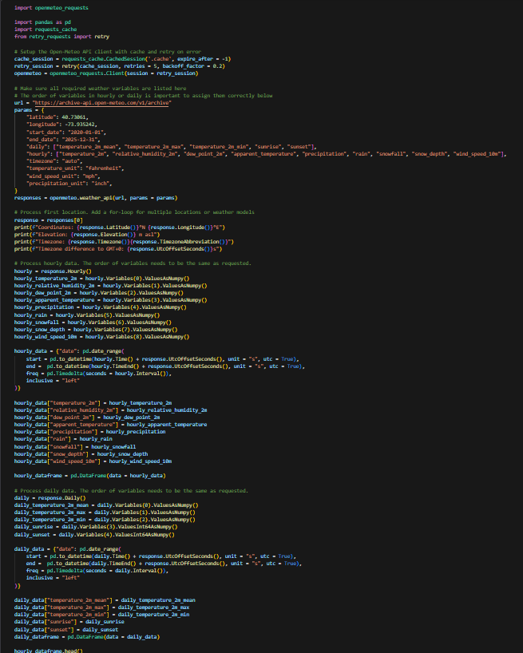
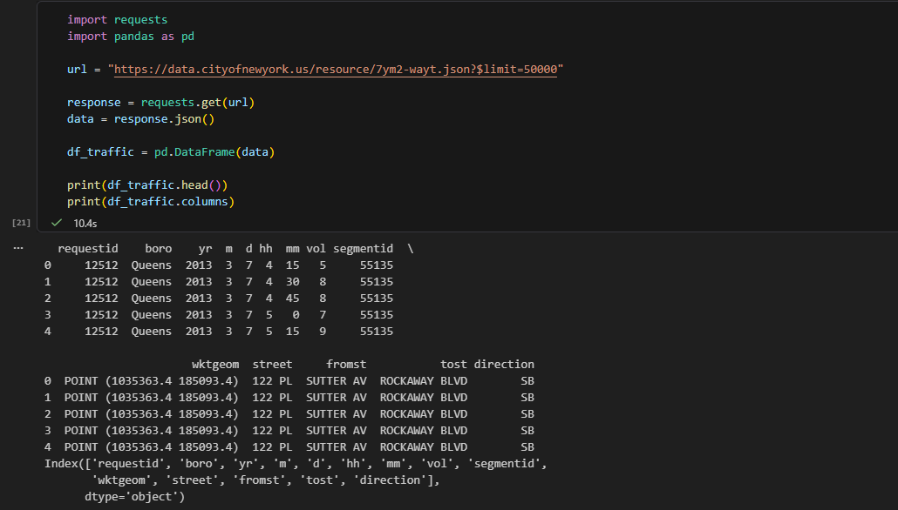
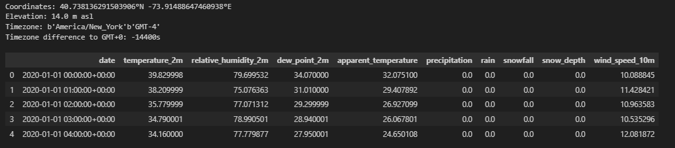

Slide 11
BUSINESS
INTELLIGENCE

Slide 12
Business Intelligence Dashboards
Live Traffic Predictions
Input today’s weather forecast
Output predicted delay by borough
Map view of congestion hotspots
City Weather Comparison
Compare rain vs delay across boroughs
Historical trends by season
A/B Model Results
Model A vs Model B accuracy charts
R² and RMSE comparison tiles
Recommendation for best-fit model

Slide 13
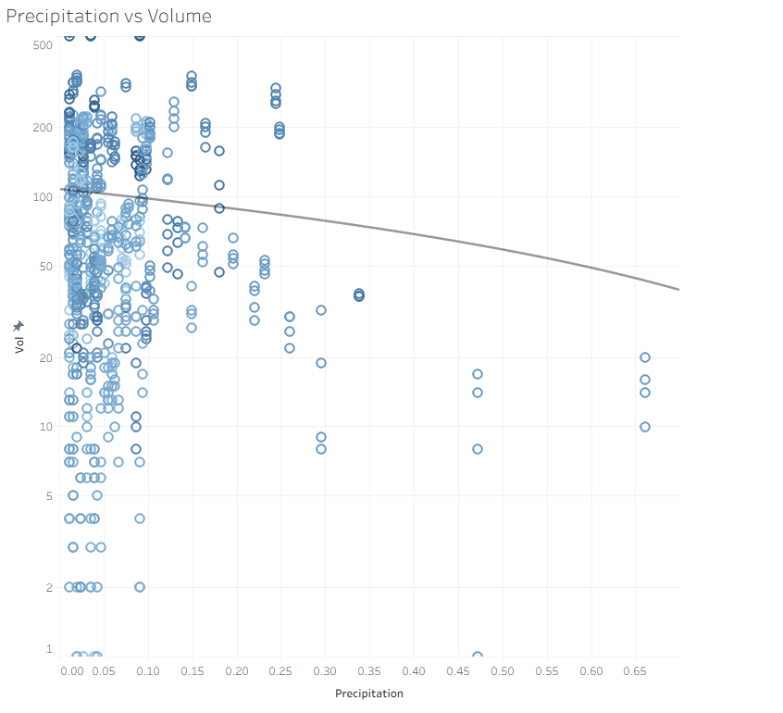

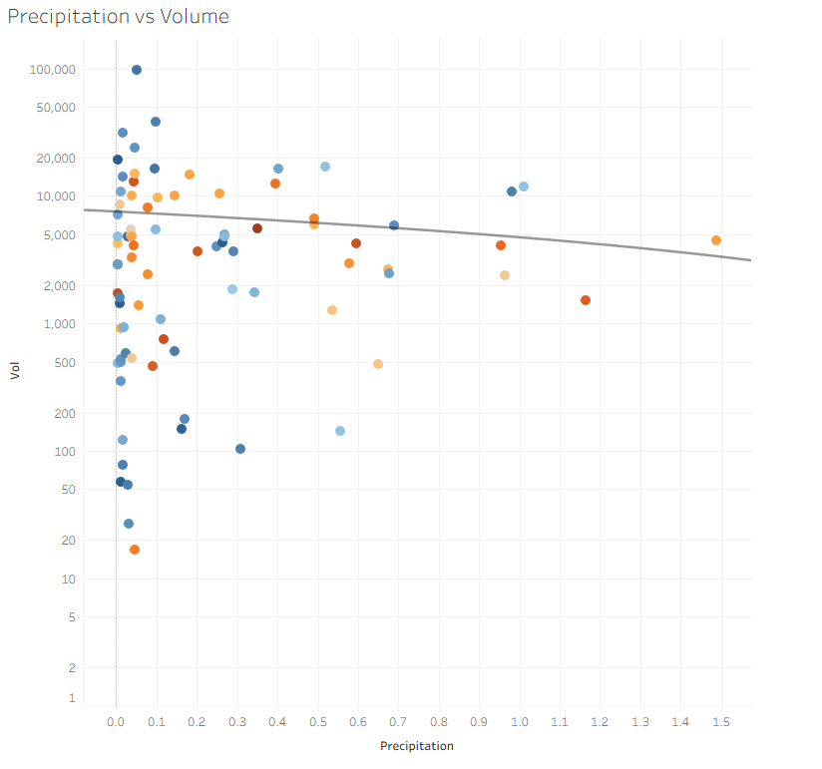

Slide 14
APPLICATION STACK

Slide 15
API:
OpenMeteo API, NYC Open Data
Language:
Python
Libraries:
Pandas
Requests
Seaborn
Matplotlib
Numpy
scikit-learn
Visuals:
Tableau
Database:
MySQL
Forecasting:
Tableau Native + sklearn (regression)
THE STACK

Slide 16
Atif Tausif
Data Engineering + Lead
Tausif Tusar
Data Analyst
Mahdi Mahin
ML Engineer
Raian Pial
BI Dashboards
Sushanta Sapkota
Data Analyst
Subject to change
MEMBER ROLES

Slide 17
Q&A

